Slide 1
From Supervised Baselines to Positive–Unlabeled Learning: Fake News Detection on the TruthSeeker2023 Ground-Truth
Vishnu Rohith Nanduri
Department of Computer Science Bagley College of Engineering
Mississippi State University
vn212@msstate.edu

Slide 2
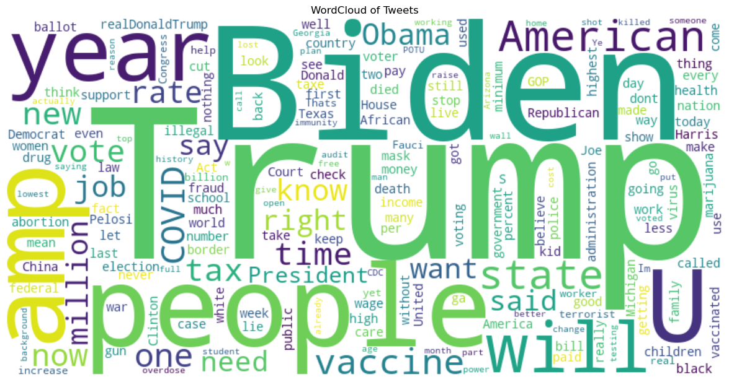
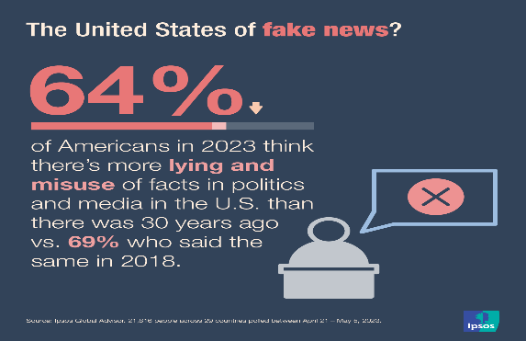
Introduction
Social media platforms like Twitter spread news at massive scale.
A significant portion of this content is misinformation / fake news.
Detecting fake news is crucial for maintaining trust and integrity in online platforms.
Notes:
On April 23, 2013, the official Twitter account of the Associated Press (AP) was hacked. A fake breaking-news tweet was posted claiming that explosions had occurred at the White House and that President Obama was injured. Because AP is a globally trusted news outlet, the tweet was immediately treated as credible and spread extremely fast across Twitter and other media.
Within seconds, financial markets reacted. Both human traders and automated/high-frequency trading systems that scan news and social media interpreted the tweet as real and rapidly sold off stocks. The Dow Jones Industrial Average dropped about 143 points almost instantly, and broader market value fell sharply for a few minutes. Once AP publicly confirmed the hack and stated the tweet was false, the market rebounded quickly.
The key takeaway is that a single false tweet from a credible account can cause measurable real-world financial damage before verification is possible. It demonstrates the speed and scale at which misinformation can propagate on Twitter/X, and why automated detection systems are needed—humans cannot react fast enough to prevent short-term harm. This incident is often cited as a textbook case of social-media misinformation impacting national-level financial stability.

Slide 3
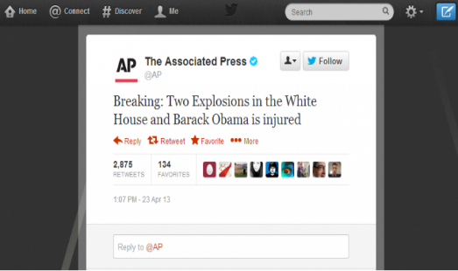
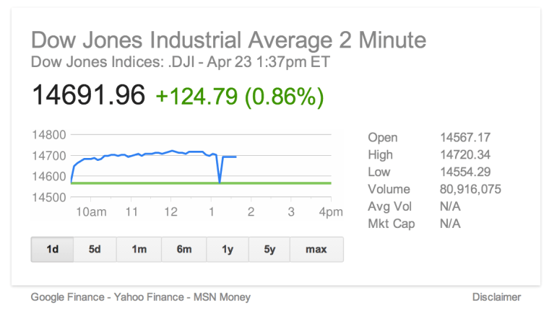
Real-World Scenarios
Associated Press’s Twitter account was hacked and posted a false tweet claiming explosions at the White House and the president injured.
The tweet spread instantly and was treated as credible in the first minutes.
Dow dropped ~143 points and the S&P 500 briefly lost ~$136B before recovering.
Notes:
On April 23, 2013, the official Twitter account of the Associated Press (AP) was hacked. A fake breaking-news tweet was posted claiming that explosions had occurred at the White House and that President Obama was injured. Because AP is a globally trusted news outlet, the tweet was immediately treated as credible and spread extremely fast across Twitter and other media.
Within seconds, financial markets reacted. Both human traders and automated/high-frequency trading systems that scan news and social media interpreted the tweet as real and rapidly sold off stocks. The Dow Jones Industrial Average dropped about 143 points almost instantly, and broader market value fell sharply for a few minutes. Once AP publicly confirmed the hack and stated the tweet was false, the market rebounded quickly.
The key takeaway is that a single false tweet from a credible account can cause measurable real-world financial damage before verification is possible. It demonstrates the speed and scale at which misinformation can propagate on Twitter/X, and why automated detection systems are needed—humans cannot react fast enough to prevent short-term harm. This incident is often cited as a textbook case of social-media misinformation impacting national-level financial stability.

Slide 4


Real-World Scenarios
A false “Pizzagate” conspiracy accused Democratic leaders of running a child-trafficking ring via a D.C. pizzeria (Comet Ping Pong).
The claim spread rapidly on Twitter/X through viral hashtags and influencer amplification, despite no supporting evidence.
On Dec 4, 2016, a man entered Comet Ping Pong with a rifle and fired shots while “investigating” the fake story.
Notes:
Pizzagate was a major misinformation episode during the 2016 U.S. presidential election. The conspiracy theory falsely claimed that top Democratic figures, including Hillary Clinton and her campaign associates, were involved in a child-trafficking ring supposedly operating out of Comet Ping Pong, a pizza restaurant in Washington, D.C. The rumor originated from misinterpretations of leaked political emails and then spread through fringe websites, but it became widely visible because it went viral on social media—especially Twitter/X—where hashtags like #Pizzagate and coordinated sharing amplified the false narrative far beyond its original sources.
Even after journalists, law enforcement, and fact-checking organizations found no evidence supporting the claims, Twitter discussions continued to grow. The restaurant’s owner and employees were subjected to sustained harassment, threats, and doxxing, illustrating how online misinformation can directly harm individuals who are falsely targeted.
The situation escalated into real-world violence on December 4, 2016, when Edgar Maddison Welch traveled from North Carolina to Comet Ping Pong with an assault-style rifle and fired multiple shots inside the restaurant. He later stated he came to “self-investigate” and rescue alleged victims, showing a direct chain from fake tweets → belief → offline action. No one was physically injured, but the event is widely cited as a clear example of political misinformation on Twitter producing real, dangerous consequences.

Slide 5
Context
Motivation & Problem Statement
Dataset: TruthSeeker2023
Preprocessing & Feature Engineering
Supervised Learning Baselines
Positive–Unlabeled (PU) Setup
Positive–Unlabeled (PU) Learning Methods
Results & Comparative Analysis
Conclusions, Limitations & Future Work
Notes:
Till now we have just seen the jist of the project, going deep into the project’s presentation, I’ll start by introducing the problem and why detecting fake news on Twitter matters. Then I’ll describe the TruthSeeker2023 dataset I have used and how I processed tweets into TF-IDF vectors and other few metadata features. After that, I’ll show supervised learning baselines and their metrics, followed by PU learning methods that simulate realistic label scarcity. Finally, I’ll compare results, discuss insights and limitations, and wrap up with future directions.

Slide 6
Problem Statement
Social media platforms (e.g., Twitter/X) enable rapid and large-scale spread of misinformation, often faster than verified news.
Traditional fake-news detection models rely on fully labeled data, but real-world labels are scarce, noisy, and expensive to obtain through fact-checking.
High false positives or false negatives can either censor real information or allow harmful fake content, reducing public trust and increasing societal risk.
Notes:
First, social media platforms like Twitter or X enable information to spread extremely fast and at massive scale. The key issue is that misinformation often spreads faster than verified news, because posts can go viral in minutes before anyone checks their accuracy. So the platform dynamics themselves create a favorable environment for fake content to grow quickly.
Second, if we look at most traditional fake-news detection models, they rely on fully labeled datasets, meaning they assume we already know which tweets are real and which are fake. But that assumption doesn’t hold in the real world. Reliable labels require fact-checking, and that process is scarce, noisy, and expensive. Fact-checkers can only verify a small portion of content, and even then, some cases are ambiguous or delayed. So getting a perfectly labeled dataset at social-media scale is not realistic.
Third, classification errors in fake-news detection is significant. If the model produces false positives, it can incorrectly flag real content as fake, which is a form of censorship and harms public trust. On the other hand, false negatives allow harmful fake content to remain visible and potentially influence people. So balancing these errors is critical because either side creates societal risk.
That leads directly to the question at the bottom of the slide:
Can we accurately detect fake news on social media with only a small set of verified labels?
This is the real deployment condition, not the idealized supervised condition.
And this is where PU learning comes in.
In real social media settings, we rarely know all real and fake tweets with certainty. Most of the time, only a small subset of tweets is verified by fact-checkers.
The rest of the tweets are simply unlabeled, not because they are automatically real, but because no one has checked them yet.
So the data naturally takes a PU structure:
P, which is the verified positives — for example, tweets confirmed as fake news through fact-checking.
U, which is everything else — a mixed pool containing real tweets plus hidden fake tweets.
The important point is: unlabeled does not mean negative.
So in this project, I first built supervised models as strong baselines using the fully labeled dataset — this shows the best-case performance when labels are complete. Then I moved to PU learning to simulate the real world, where only a limited set is labeled and the rest is unlabeled. This allows me to evaluate how well fake-news detection can work under practical, label-scarce conditions.”

Slide 7
BUT WHY PU?
We rarely know all fake and real tweets with certainty.
Usually, only a small subset is verified by fact-checkers. The rest of the tweets are unlabeled.
So, the data naturally becomes: P = verified positives (e.g., confirmed fake news) U = everything else (mix of real + hidden fake)
Unlabeled ≠ Negative
Notes:
This is the real deployment condition, not the idealized supervised condition.
And this is where PU learning comes in.
In real social media settings, we rarely know all real and fake tweets with certainty. Most of the time, only a small subset of tweets is verified by fact-checkers.
The rest of the tweets are simply unlabeled, not because they are automatically real, but because no one has checked them yet.
So the data naturally takes a PU structure:
P, which is the verified positives — for example, tweets confirmed as fake news through fact-checking.
U, which is everything else — a mixed pool containing real tweets plus hidden fake tweets.
The important point is unlabeled does not mean negative. As this is not a simple 2 label classification problem, we need to consider Unlabeled as a mix of Positives and Negatives ( Mix of Real and Fake tweets) to match the real-world scenario.
So in this project, I first built supervised models as strong baselines using the fully labeled dataset — this shows the best-case performance when labels are complete. Then I moved to PU learning to simulate the real world, where only a limited set is labeled, and the rest is unlabeled. This allows me to evaluate how well fake-news detection can work under practical, label-scarce conditions.”

Slide 8
Objective
Load the dataset and required dependencies.
1
Preprocess using the TruthSeeker2023 dataset (tweet text + user/engagement metadata) and finally convert it to TF-IDF features.
2
Establish strong supervised learning baselines by training multiple fully-labeled classifiers on TF-IDF + numeric features.
3
Apply and evaluate multiple Positive–Unlabeled (PU) learning methods to model realistic label-scarcity settings.
4
Compare supervised vs PU performance using metrics (F1, Precision, Recall, ROC-AUC, PR-AUC, MCC) and result visualizations.
5
Notes:
“Now I’ll walk through the objective and overall workflow of my project. I structured this work into five clear stages, shown in this pipeline.
Step 1 is to load the dataset and required dependencies. Here, I start by importing the TruthSeeker2023 dataset and setting up all libraries needed for text processing, feature engineering, supervised learning models, and PU learning models. This stage ensures the data is correctly read, the labels are understood, and the environment is ready for reproducible experiments.
Step 2 is preprocessing using the TruthSeeker2023 dataset. In this project, the raw input includes tweet text along with user and engagement metadata. So, I first clean the tweet text. After cleaning, I convert the text into numerical features using TF-IDF.
At the same time, I keep important numeric metadata features such as user credibility and engagement signals. This step produces the final feature representation that combines TF-IDF text vectors + numeric features, which becomes the input to all models.
Step 3 is establishing strong supervised learning baselines. Before moving to PU learning, I train multiple fully-labeled supervised classifiers on the same feature set. This gives me a best-case benchmark—basically how well fake news detection performs when we assume all tweets are labeled real or fake. These baselines are important because they help interpret PU performance later and show what is achievable under ideal conditions.
Step 4 is applying and evaluating multiple PU learning methods. To simulate real social-media conditions, I convert the training data into a PU setting—where only a fraction of positive tweets remain labeled, and the rest become unlabeled. Then I implement multiple PU algorithms such as Elkan-Noto, PU Bagging, and Two-Step PU. The goal here is to evaluate how fake news detection works when labels are limited, which is closer to how real platforms operate.
Step 5 is comparing supervised vs PU performance. Finally, I evaluate all models on the same test set using consistent metrics.

Slide 9
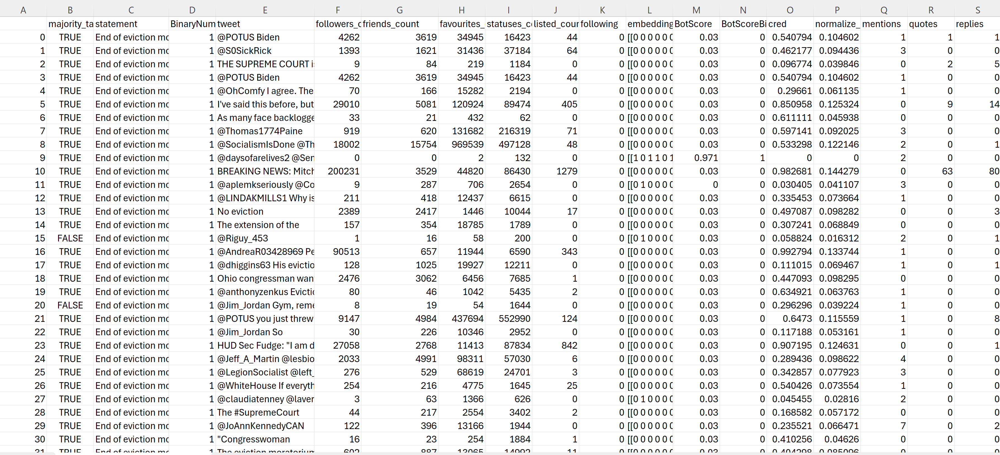
CIC truth seeker dataset 2023 (TruthSeeker2023)
TruthSeeker2023 is one of the largest ground-truth fake-news Twitter/X datasets, with 180K+ labeled tweets.
Tweets were collected using keywords from PolitiFact real/fake news statements, linking tweets to verified claims.
Labels come from majority-vote human verification (AMT) with active-learning support, giving reliable real/fake targets.
Provides ready-made feature sets (text, lexical, metadata + bot/credibility/influence scores) for traditional ML and deep models.

Slide 10
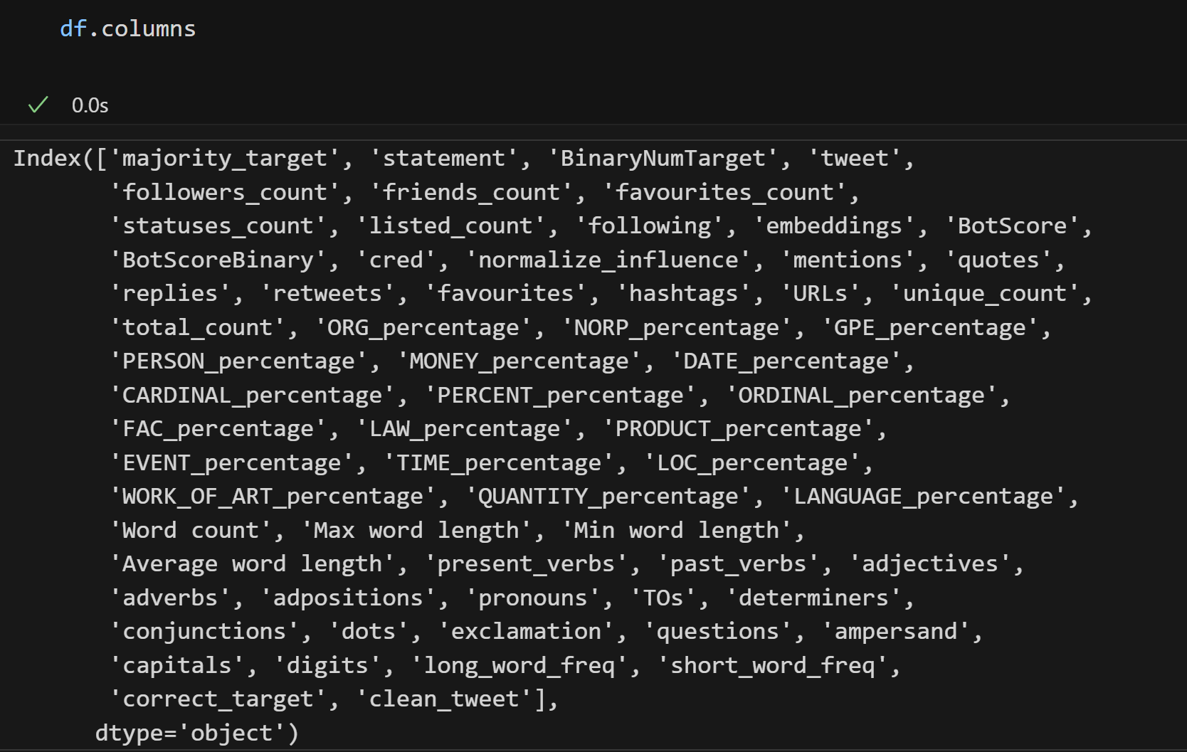
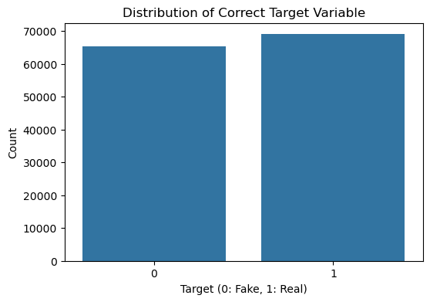

Slide 11
Data Preprocessing
Quick Sanity Check, - To get the summary of the dataset, missing values if any, duplicate values.
No Missing Values found.
Data Shape - (134198, 64)
Data Distribution, Real Tweets – 68985
Fake Tweets – 65213
Next Steps before Modelling include,
Regex Cleaning → TF-IDF → Train/Test Split

Slide 12
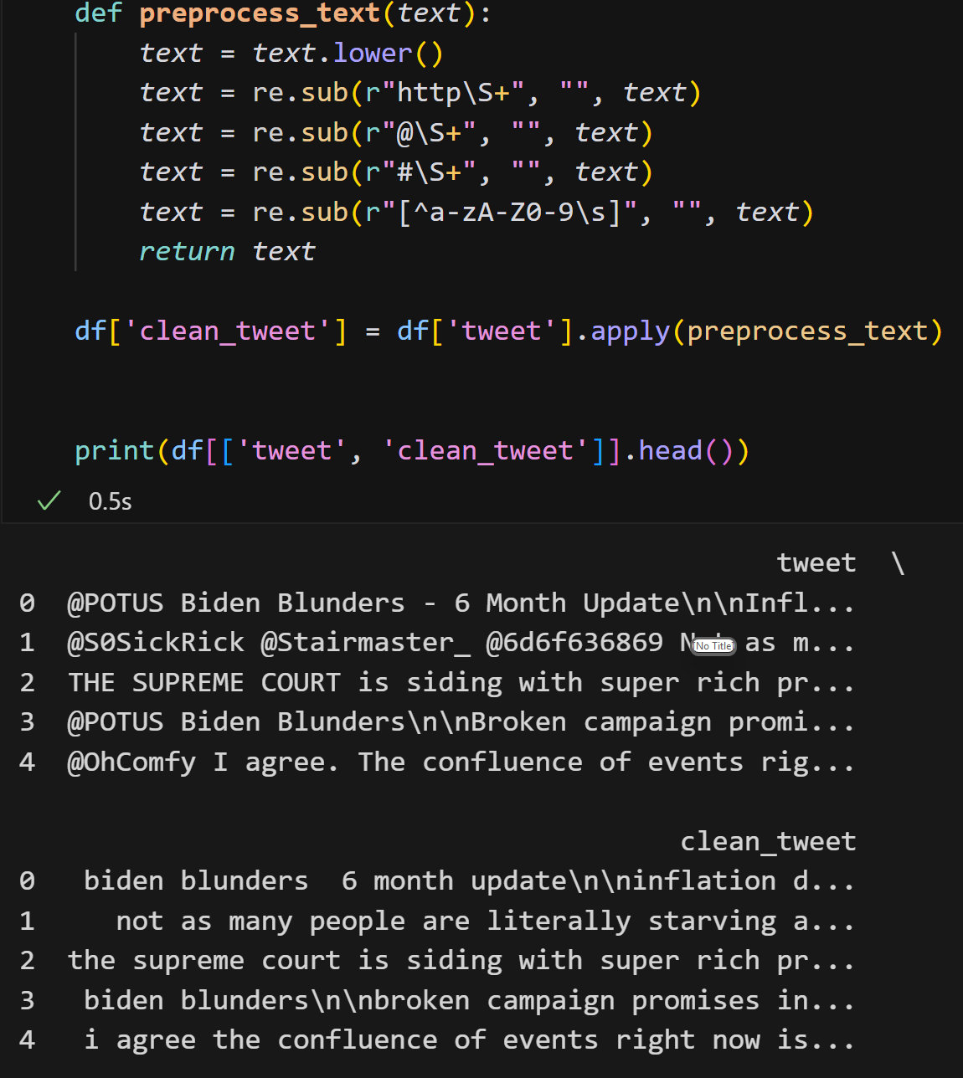
Next Steps…
Raw tweet text contains noise (URLs, @mentions, hashtags, emojis, punctuation).
Applied regular-expression based cleaning to standardize text.
Output stored as clean_tweet for feature extraction.
This makes the tweet ready for the TF-IDF vectorization.
Notes:
Tweets are short but very noisy. Regex cleaning is required for next immediate step which include TF-IDF vectorization. If we directly vectorize raw tweets, TF-IDF picks up random tokens like links, usernames, repeated punctuation, or hashtag symbols. Regex cleaning removes these non-semantic elements and normalizes the text. The goal is not to “change meaning” but to reduce noise and make the text representation consistent across all tweets.

Slide 13
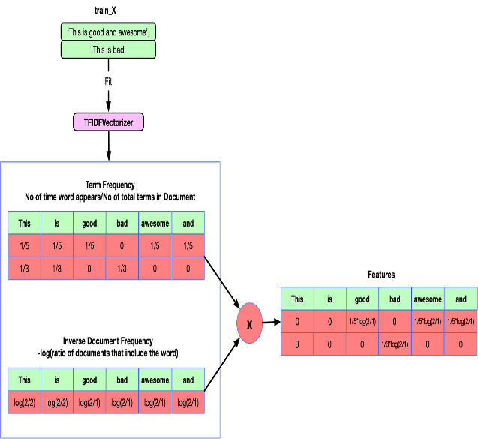
TF-IDF Vectorization
Goal: Convert cleaned tweet text into numerical features usable by ML models.
TF (Term Frequency): Measures how often a word appears in a tweet.
IDF (Inverse Document Frequency): Down-weights common words (e.g., “the”, “is”) and up-weights rare but informative words.
TF-IDF Score = TF × IDF → importance of a word in a tweet relative to the whole dataset.
Produces a sparse high-dimensional vector per tweet capturing language patterns of Real vs Fake tweets.
Final Dataset Shape post TF-IDF conversion, TF-IDF matrix shape: (134198, 5000)
TF(t) = (Number of times term x appears in a document) / (Total number of terms in the document)
IDF(t) = log_e(Total number of documents / Number of documents with term x in it)
Notes:
The tf-idf weight is composed by two terms: the first computes the normalized Term Frequency (TF) which refers to the the number of times a word appears in a document divided by the total number of words in that document. The second term is the Inverse Document Frequency (IDF) which is calculated as the logarithm of the number of the documents in the corpus divided by the number of documents where the specific term appears.
TF-IDF is a standard way to represent text into vectors for classical machine-learning models. Since models like Logistic Regression, SVM, Random Forest, etc., can’t understand raw words, we need to transform each tweet into numbers.
Term Frequency measures how frequently a term occurs in a document. As every document is different in length, it is possible that a term would appear much more times in long documents than shorter ones. Hence, the term frequency is often divided by the document length to normalise the data. The TF part looks inside a tweet and asks: “How frequently does this word appear in this tweet?” Inverse Document Frequency measures the significance of a word. In calculating TF, all terms are considered equally significant. However, it is known that certain terms, such as “and”, “the” may appear a lot of times but have little importance. Therefore, we need to weigh down the frequent terms while scale up the rare ones

Slide 14
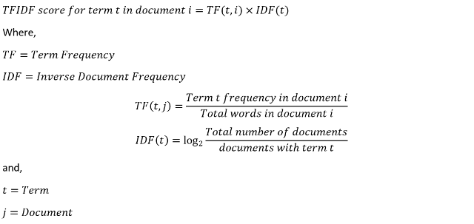
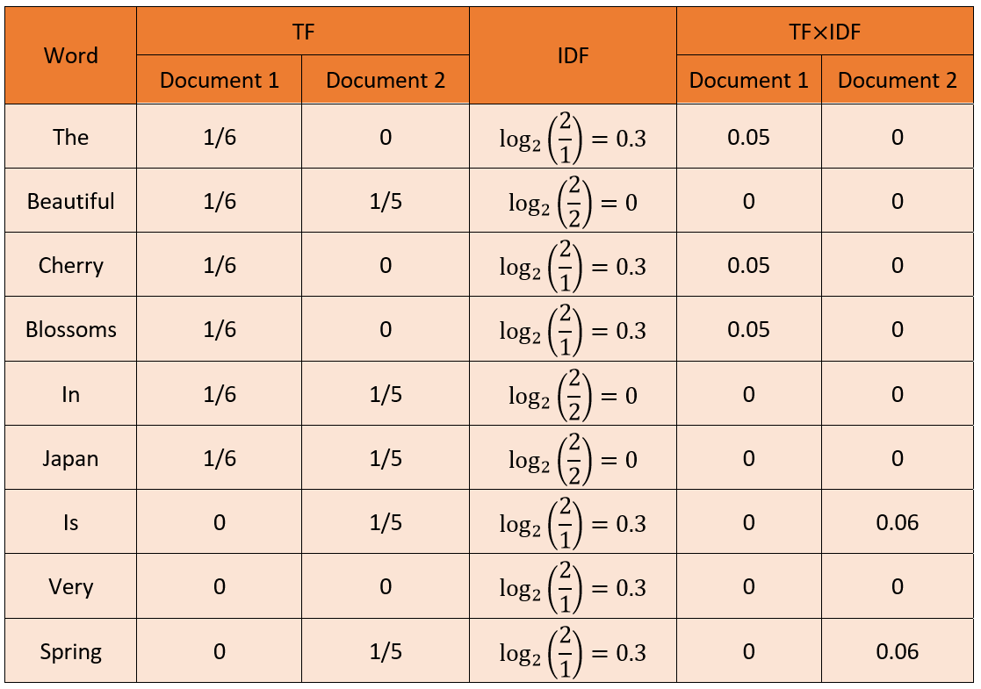
Let’s take an example,
Sentence 1: The beautiful cherry blossoms in Japan.
Sentence 2: Japan is beautiful in spring.
Non-Significant words become 0 and words like “the”, “cherry”, “blossoms”, “is”, “spring” are non-zero. NOTE: Words like “the” and “is” are usually considered common/stopwords and often end up with very low TF-IDF, but here in our example they are non-zero only because the corpus is tiny (2 docs)
Notes:
This example shows how TF-IDF is calculated. We start with two short documents (tweets): Here document refer to a tweet.
Document 1: “The beautiful cherry blossoms in Japan.”
Document 2: “Japan is beautiful in spring.” Document 1 has 6 words, so each appearing word has TF = 1/6. Example: “the”, “cherry”, “blossoms” each appear once → TF = 1/6.
Document 2 has 5 words, so each appearing word has TF = 1/5. Example: “is”, “spring” each appear once → TF = 1/5.
Here, total documents = 2.
If a word appears in both documents, then documents containing term = 2 → IDF = log(2/2) = log(1) = 0.
In this example, “beautiful”, “in”, and “Japan” appear in both docs. So their IDF becomes 0 in the table.
If a word appears in only one document, then documents containing term = 1 → IDF = log(2/1) = log(2) ≈ 0.3 (as shown in your slide).
In this example, unique words like “the”, “cherry”, “blossoms” (only in Doc1) and “is”, “spring” (only in Doc2) get IDF ≈ 0.3.
So IDF is basically saying:
“Common words across documents are less informative. Rare words are more informative. Final step is a cross product of the TF and IDF. TF-IDF is useful because it doesn’t just count words — it measures how important a word is to a specific tweet compared to the whole dataset. In fake news detection, this matters because real and fake tweets often use different language patterns. Fake tweets tend to include more emotionally charged, sensational, or misleading phrases, while real tweets are more neutral and factual. TF-IDF helps capture these differences by giving higher weight to such distinctive words.
Another reason TF-IDF fits this project is that tweets are short. With short text, simple bag-of-words counts can be noisy, but TF-IDF stabilizes the representation by emphasizing informative terms and suppressing generic terms.
Finally, TF-IDF produces a sparse, high-dimensional representation, which works especially well with the supervised baselines I used. It also integrates cleanly into PU learning because the PU methods depend on reliable probability estimation from text signals, and TF-IDF provides a strong, interpretable text feature space for that.

Slide 15
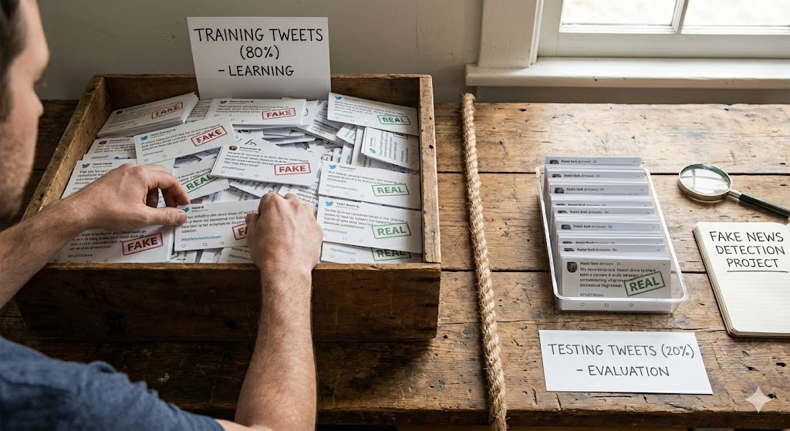

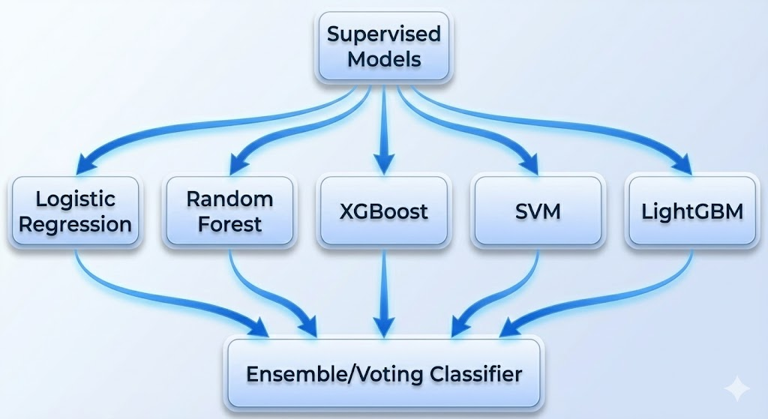
Modeling Setup and Approach (Supervised)
Supervised learning is a ML approach where the model is trained on labeled data (Model has an input and a known correct output).
Model learns on known labels and predicts on unseen data.
Fully labeled baseline: Trained models using complete ground-truth labels (Real vs Fake).
Best-model selection: Compared models on test metrics and chose top performer as the benchmark before PU learning.
Used 3-fold cross-validation to get a robust, split-independent performance estimate, enabling fair comparison and reducing overfitting risk.
Notes:
supervised learning, which serves as the baseline before moving to PU learning. In supervised learning, the model is trained on data where every input has a known correct label. In my case, each tweet is labeled as Real (1) or Fake (0), so the model learns a direct mapping from features to the correct class.
The dataset was split 80% for training and 20% for testing, The test set is kept untouched for final evaluation.
I trained multiple supervised models — Logistic Regression, Random Forest, SVM, XGBoost, and LightGBM — to see which algorithm performs best on this problem. Since performance can vary depending on how the data is split, I evaluated every supervised model using 3-fold cross-validation on the training set. This produces a more reliable, split-independent estimate and makes model comparison fairer.
Finally, I compared models using metrics like Accuracy, Precision, Recall, F1-score, ROC-AUC, PR-AUC. Based on these results, I selected the best supervised model as the benchmark.

Slide 16
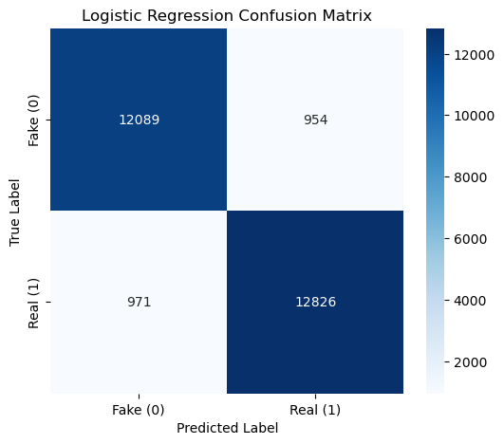
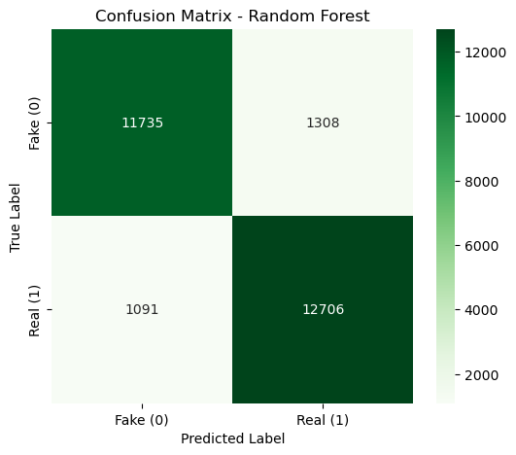
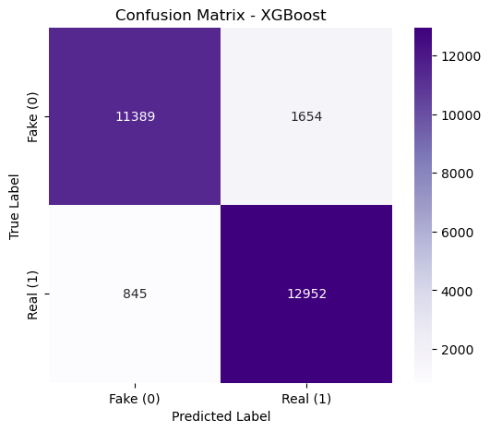
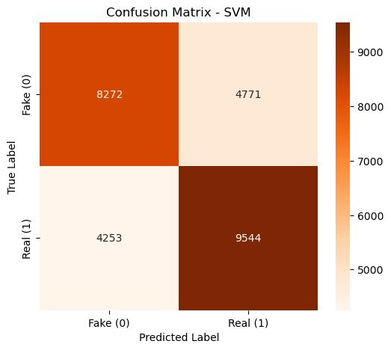

Confusion Matrix for Supervised Learning
Logistic Regression showed the best overall balance, with very low Fake→Real errors (~954) and Real→Fake errors (~971).
Random Forest performed well but had slightly more Fake→Real misses (~1308) and moderate Real→Fake errors (~1091).
XGBoost achieved the lowest Real→Fake errors (~845), but at the cost of higher Fake→Real errors (~1654).
LightGBM was nearly as strong as LR, keeping Fake→Real (~1019) and Real→Fake (~966) errors both low and balanced.
SVM underperformed, with very high errors on both sides (Fake→Real ~4771, Real→Fake ~4253), making it the weakest baseline here.
Notes:
In every matrix, rows represent the true labels and columns represent the predicted labels. So the diagonal cells are correct predictions, while the off-diagonals are mistakes.
For fake-news detection, the most critical error is when a Fake tweet is predicted as Real (top-right cell). That’s dangerous because misinformation slips through. The opposite error — Real predicted as Fake (bottom-left) — is less harmful but still affects trust and precision.
Starting with Logistic Regression, it shows the best overall balance. It has low Fake→Real errors (~954) and low Real→Fake errors (~971), giving the cleanest diagonal and about ~92.8% accuracy. This makes LR a very strong baseline for TF-IDF-based text classification.
Random Forest performs well but makes slightly more Fake→Real mistakes (~1308) and moderate Real→Fake errors (~1091). Its diagonal is still strong, but compared to LR it lets more fake tweets pass as real, so it’s a bit weaker for safety-critical detection.
XGBoost shows an interesting trade-off: it produces the lowest Real→Fake errors (~845), meaning it is very good at not flagging real tweets incorrectly. However, it has higher Fake→Real errors (~1654), so more fake tweets escape detection. This is why XGBoost looks strong on Real recall but slightly weaker on Fake detection.
Safe LightGBM is almost as strong as Logistic Regression. It keeps both Fake→Real (~1019) and Real→Fake (~966) errors low and balanced, with about ~92.6% accuracy. So LightGBM is another top supervised baseline in this project.
Finally, SVM underperformed in this setup. The confusion matrix shows very high errors on both sides — Fake→Real (~4771) and Real→Fake (~4253). That means it misses a lot of fake tweets and also incorrectly flags many real tweets, making it the weakest supervised baseline here.
Overall, these supervised results establish a strong benchmark using full labels. Logistic Regression and Safe LightGBM emerge as the best balanced supervised models, and I use these as the main reference point before moving to the PU learning phase, where labels are intentionally limited.

Slide 17
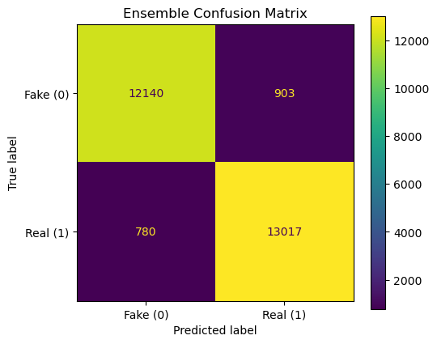
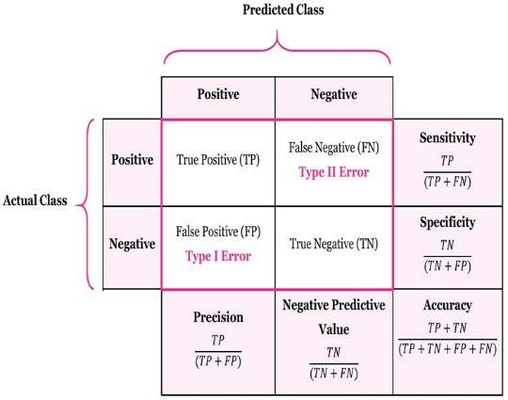
Best supervised result: Ensemble shows the lowest overall errors (Fake→Real: 903, Real→Fake: 780).
More balanced than single models: Improves on LR and LightGBM by reducing both miss types.
Notes:
Looking at the matrix, the ensemble produces the cleanest diagonal among all supervised approaches:
Fake → Real errors = 903 (top-right). These are the most critical mistakes because fake tweets slip through as real.
Real → Fake errors = 780 (bottom-left). These are false alarms where real tweets are incorrectly flagged as fake.
Compared to the earlier supervised models:
Logistic Regression and Safe LightGBM were already strong and balanced, but the ensemble improves on both by reducing both error types at the same time.
Models like Random Forest and XGBoost showed trade-offs — one side improved while the other got worse. The ensemble avoids that trade-off and delivers a better balance. the ensemble is the best supervised benchmark in this project, because it minimizes fake-miss errors while keeping false alarms low

Slide 18
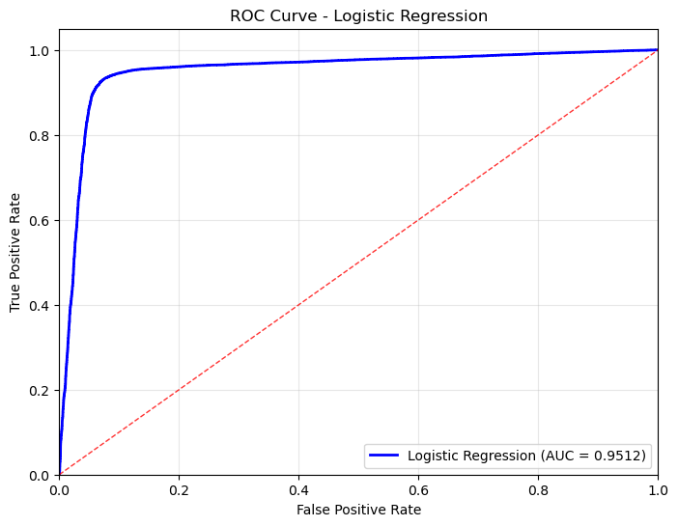
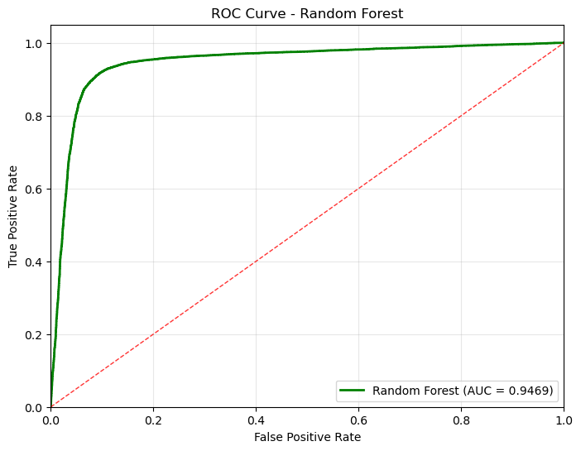
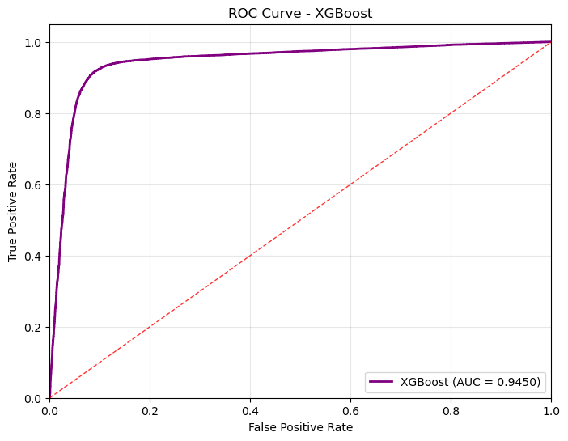
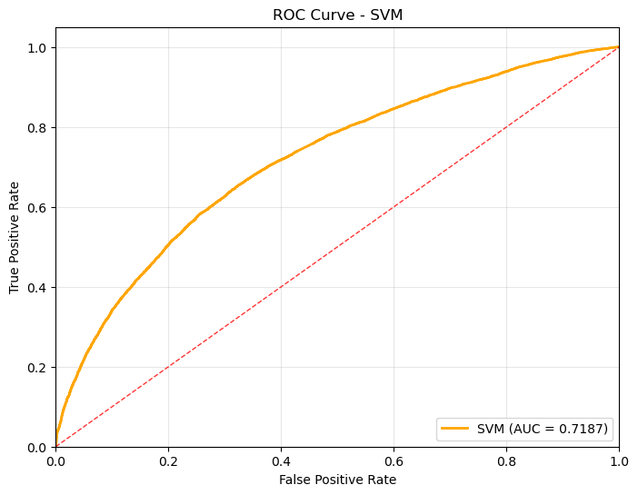
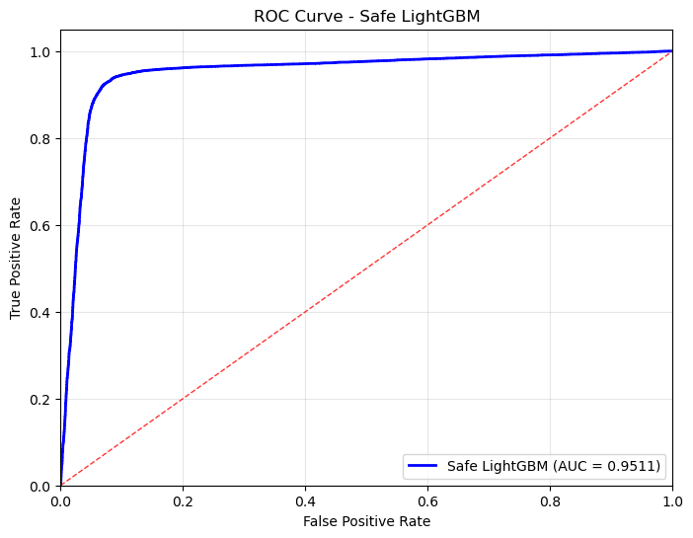
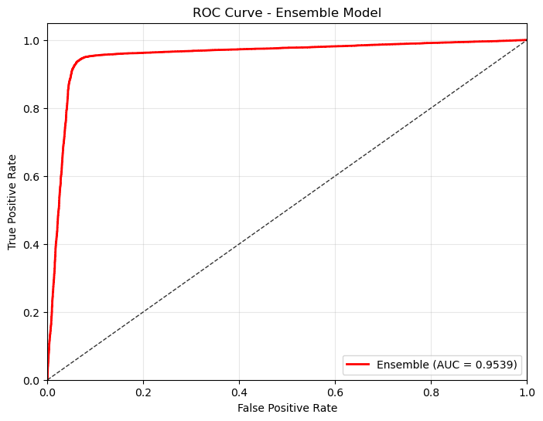
ROC-AUC Curves
Notes:
ROC–AUC is a way to evaluate classification models across all possible decision thresholds, instead of judging them at just one cutoff like 0.5.
The ROC curve plots:
True Positive Rate (TPR / Recall) on the y-axis — how many actual positives the model correctly captures.
False Positive Rate (FPR) on the x-axis — how many actual negatives are incorrectly flagged as positives. As we change the probability threshold, the model becomes more or less strict. For example, if I lower the threshold, the model labels more tweets as “positive,” so recall goes up, but false alarms increase too. The ROC curve summarizes this trade-off for every threshold from 0 to 1.
The AUC (Area Under the Curve) compresses the ROC curve into a single number:
AUC = 1.0 means perfect separation between Real and Fake tweets.
AUC = 0.5 means the model is no better than random guessing.
Higher AUC means the model is better at ranking one class higher than the other, regardless of the threshold.
In my project, ROC–AUC is important because:
Threshold-independent comparison: Before choosing a final cutoff, I needed a fair way to compare multiple supervised models. ROC-AUC tells me which model separates Real vs Fake most reliably overall.
Balanced dataset fit: Since the dataset is nearly balanced, ROC-AUC is a stable global metric alongside F1.
Benchmarking for PU learning: I first measured ROC-AUC for supervised models using full labels to establish an upper-bound baseline. Later, I compare PU models against this baseline to see how performance changes when labels are limited.
So overall, ROC–AUC helps me answer:
“Which model best distinguishes Real vs Fake tweets before we lock in any single decision threshold?”
All major supervised models except SVM achieve strong discrimination (~0.95 AUC), and the ensemble slightly improves further, so I use it as the final supervised benchmark before PU learning.”
Ensemble Model is the best overall:
AUC ≈ 0.9539, the highest on the slide.
Its curve stays slightly more toward the top-left, showing the strongest separation across thresholds.

Slide 19
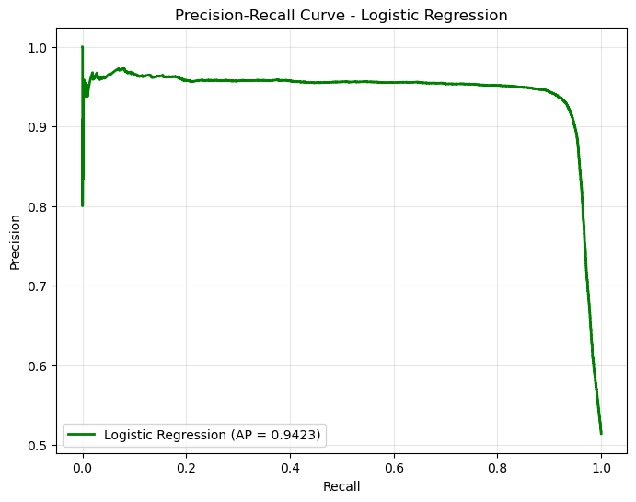
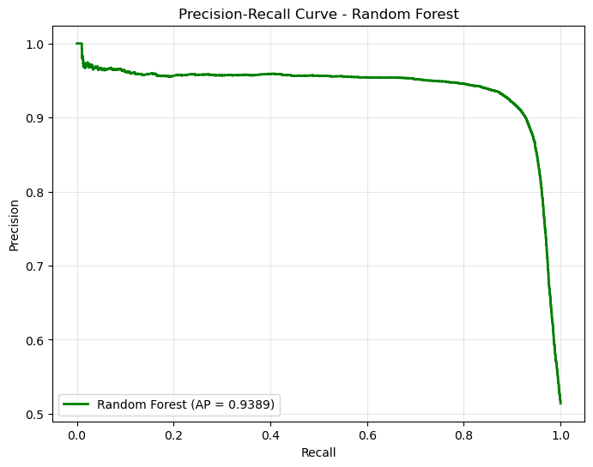
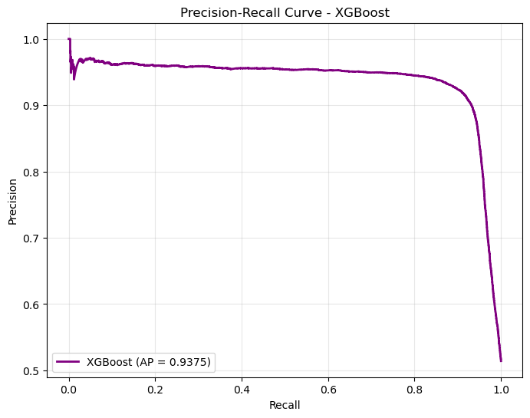
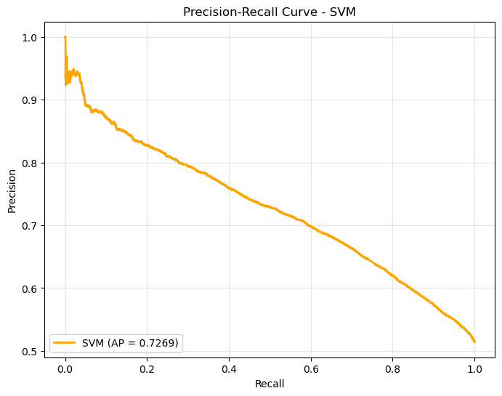
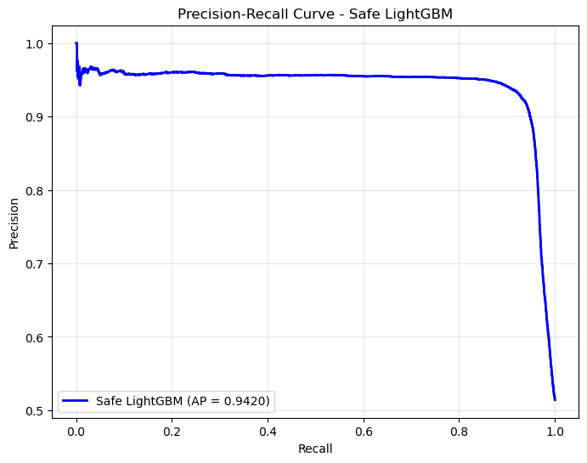
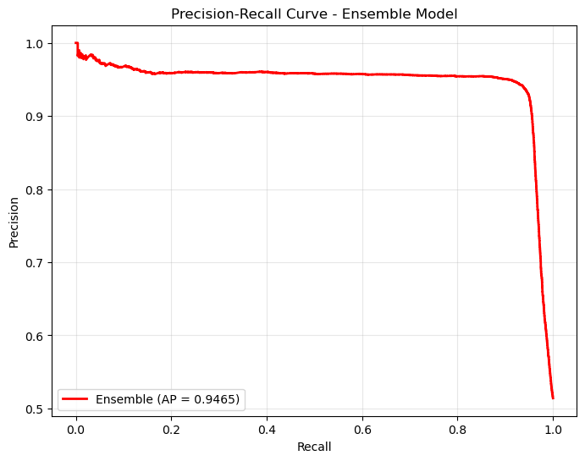
Precision Recall Curves
Precision = TP / (TP + FP)
Recall = TP / (TP + FN)
Closer to top-right
Better
(High Precision
+
high Recall)
Notes:
Precision measures how many predicted positives are actually correct (TP / (TP+FP)), and recall measures how many true positives we catch (TP / (TP+FN)). A PR curve shows how precision changes as we increase recall by moving the decision threshold.
Closer to the top-right means the model can catch more positives without losing much precision. Average Precision (AP) is the area under this curve and summarizes overall PR performance.
Why I use PR curves in this project
For fake-news detection, I care about both:
catching as many fake/real tweets as possible (high recall), and
not flagging too many correct tweets as fake (high precision). PR curves let me compare models independently of a fixed threshold and focus on the quality of positive-class predictions, complementing ROC-AUC and confusion matrices. Most models (Logistic Regression, Random Forest, XGBoost, Safe LightGBM) have high, flat curves with AP ≈ 0.94, meaning they keep precision high across a wide recall range. The Ensemble model has the best curve and highest AP (~0.9465), so it offers the strongest precision–recall trade-off and becomes my final supervised baseline. SVM clearly underperforms: its curve is much lower and AP (~0.73) is significantly worse, matching the errors we saw in its confusion matrix.

Slide 20
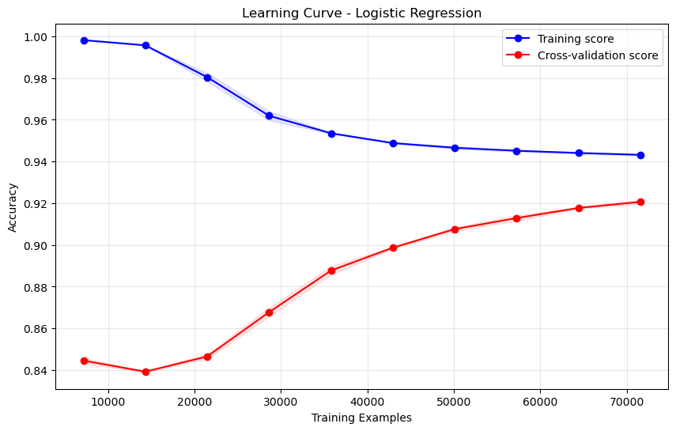
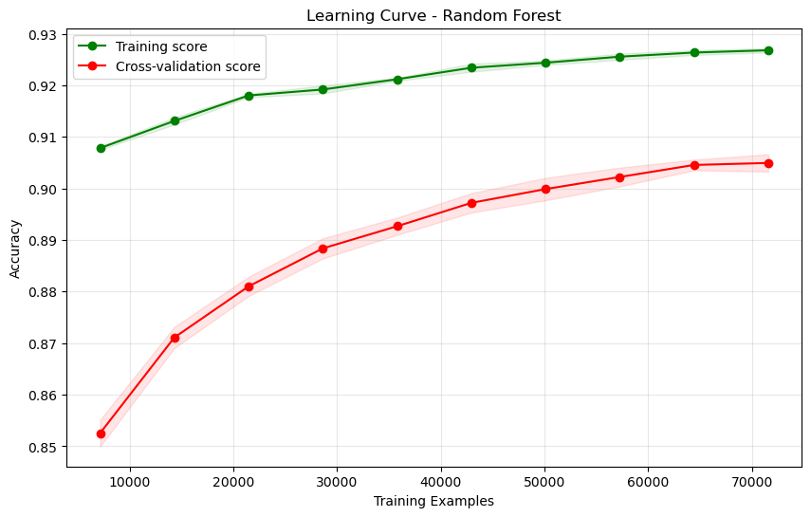
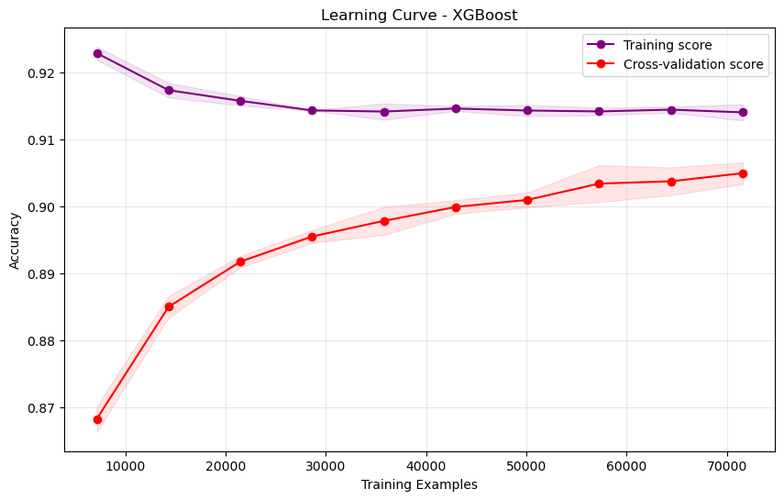
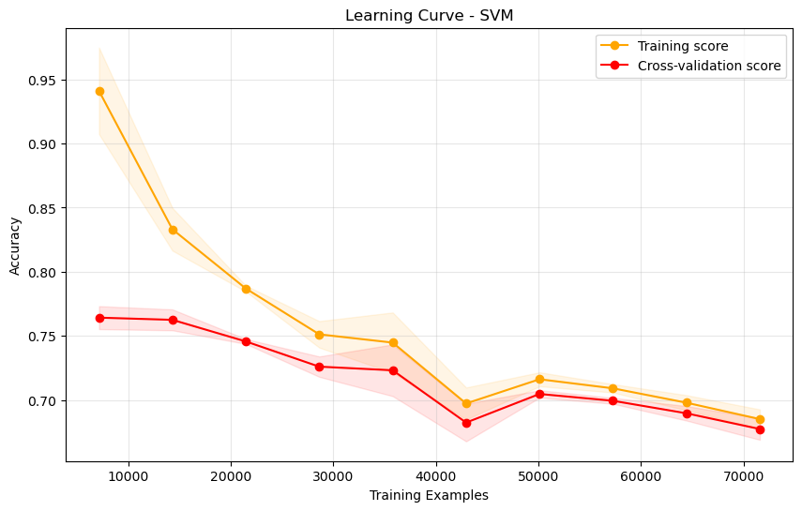
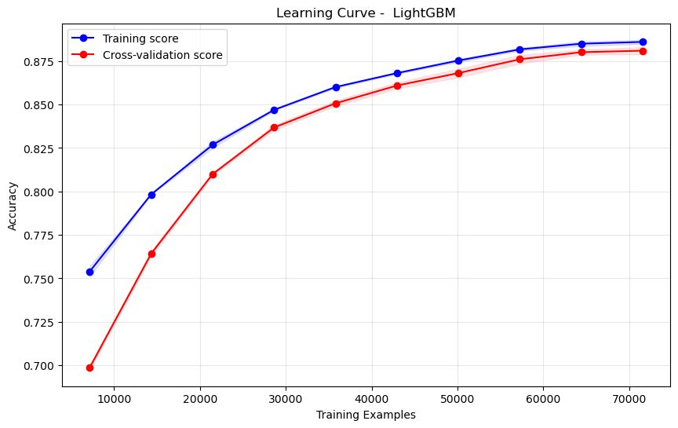
Supervised - Learning Curves
Notes:
These plots show how each supervised model behaves as I increase the number of training examples. The blue/orange lines are the training scores, and the red/green lines are the cross-validation scores.
For Logistic Regression, Random Forest, XGBoost, and LightGBM, the cross-validation curves rise quickly and then flatten out. The gap between training and validation stays small. → This tells us that with around 70k–100k labeled tweets, these models already generalize well and adding much more labeled data would give only marginal gains.
Logistic Regression and LightGBM are especially stable: training and validation lines almost touch at the end, which means low variance and low overfitting even in 5,000-dimensional TF-IDF space.
Random Forest and XGBoost also improve with more data, but you can see a slightly larger train–validation gap, which is consistent with their tendency to slightly overfit when trees are deep.
SVM behaves very differently: as we add more data, both its training and validation curves stay low and even dip, and they never catch up to the other models. → This means SVM is underfitting / poorly tuned for this high-dimensional sparse TF-IDF representation. It doesn’t benefit from the extra 130k examples the way LR or LightGBM do, which is why its final metrics are much lower in the earlier slides. “These plots are learning curves. On each graph, the x-axis is the number of training examples, and the y-axis is the model’s accuracy. Each model has two lines:
a training score line – how well it fits the data it was trained on,
and a cross-validation score line – how well it generalizes to unseen data.
As we move to the right and add more training data, we can see how both lines evolve.”
2. Why learning curves are useful
“I use learning curves for three things:
Do we have enough labeled data? If the validation curve keeps rising, more data will still help. If it plateaus, we are in the ‘diminishing returns’ zone.
Check underfitting vs overfitting. A big gap between train and validation means overfitting; both curves low and close together means underfitting.
Compare algorithms on this TF-IDF setup. They tell us which models actually benefit from our 130k × 5020 TF-IDF representation.”
3. What the curves tell us in this project
“For Logistic Regression, Random Forest, XGBoost, and LightGBM, the validation curves rise quickly and then flatten. The training and validation lines end up quite close together.
That means with around 70k+ training tweets, these models have already extracted most of the signal; adding many more labels would not dramatically change performance.
The small gap also shows that Logistic Regression and LightGBM, in particular, generalize well and are not heavily overfitting, despite the high-dimensional (5020-feature) TF-IDF space.
SVM behaves very differently:
Its training and validation curves stay much lower and hardly improve as we add data.
This pattern tells us the issue is not a lack of data – it’s that SVM is a poor fit or poorly calibrated for this large, sparse TF-IDF representation.
That matches what we saw in the metrics and radar plot where SVM was the weakest model.”
4. Why LR & LightGBM are good single models (and SVM is not)
“These curves support why Logistic Regression and Safe LightGBM are my best single models:
With TF-IDF features, the data are high-dimensional and sparse. Logistic Regression is a linear model with L2 regularization, which works very well in this regime – it scales to many features and learns a simple, stable separating hyperplane. Its learning curve shows high accuracy with a small train–test gap.
LightGBM is a gradient-boosted tree ensemble. It can capture non-linear interactions between TF-IDF and numeric features, and it keeps improving as data grows until it plateaus, with training and validation lines staying close – so it also generalizes well.
In contrast, SVM doesn’t improve much with more data and sits at a much lower accuracy level. For this 130k × 5020 TF-IDF dataset, SVM is either underfitting or not tuned for the right kernel/regularization, which is why it ends up as the lowest performer.”
5. Why LR and XGBoost curves “start from opposite sides”
“You might notice that Logistic Regression starts with very high training accuracy and low validation accuracy, and then the two move towards each other as we add data. That’s normal: with a tiny training set, LR can almost perfectly fit those few points, so the training score is overly optimistic, while validation is low. As we add data, the model is forced to generalize, so training accuracy drops slightly and validation accuracy rises, and they converge.
For XGBoost and Random Forest, both training and validation scores rise together with more data. Tree ensembles start more conservative on tiny datasets and need more samples to learn good splits. As data increases, both curves improve and then plateau, with training always a bit above validation, which is the usual behaviour for these models.”

Slide 21
Supervised Final Metrics
Model | Accuracy (%) | Precision (%) | Recall (%) | F1-Score | ROC-AUC | PR-AUC
Logistic Regression | 92.83 | 93.08 | 92.96 | 93.02 | 95.12 | 94.23
Random Forest | 91.06 | 90.67 | 92.09 | 91.37 | 94.69 | 93.89
XGBoost | 90.69 | 88.68 | 93.88 | 91.20 | 94.50 | 93.75
SVM | 66.38 | 66.67 | 69.17 | 67.90 | 71.87 | 72.69
Safe LightGBM | 92.60 | 92.64 | 93.00 | 92.82 | 95.11 | 94.20
Ensemble | 93.73 | 93.51 | 94.35 | 93.93 | 95.39 | 94.65
Notes:
This table summarizes the final supervised performance for all models across the main metrics: Accuracy, Precision, Recall, F1-score, ROC-AUC, and PR-AUC. All values are percentages on the same held-out test set.
First, we can see that Logistic Regression and Safe LightGBM are very strong and well balanced. Both are around 92–93% on accuracy and F1, with ROC-AUC and PR-AUC around 95% and 94%, which confirms what we saw from the ROC and PR curves.
Random Forest and XGBoost are slightly weaker but still competitive. XGBoost, in particular, has higher recall but a bit lower precision, which matches the confusion matrices where it caught more positives but allowed more false positives.
SVM clearly stands out as the weakest supervised model. Its accuracy and F1 are around the mid-60s to high-60s, and its ROC-AUC and PR-AUC are much lower than the others. This is consistent with its confusion matrix and its poorer ROC/PR curves.
Finally, the Ensemble model gives the best overall performance. It has the highest accuracy (about 93.7%), the highest F1-score (~93.9%), and the strongest ROC-AUC and PR-AUC values. So this ensemble is the final supervised baseline I use when I later compare against the PU learning approaches.

Slide 22
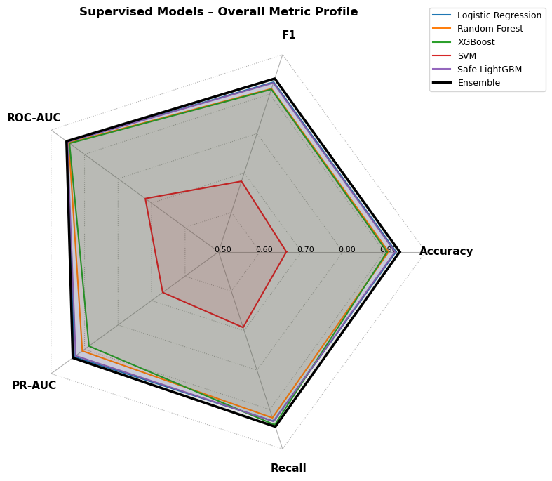
Most supervised models cluster near the outer edge, showing consistently high Accuracy, F1, ROC-AUC, PR-AUC, and Recall.
Best performer: The Ensemble forms the outermost polygon on almost every axis → best overall balance across all metrics.
Strong single models: Logistic Regression and Safe LightGBM closely follow the ensemble, with very similar multi-metric profiles.
Weak baseline: SVM forms the smallest inner polygon, clearly lagging behind the other models on every metric.
Notes:
This radar chart puts all supervised models and all main metrics on one picture. Each axis is one metric — Accuracy, F1, ROC-AUC, PR-AUC, Recall — and each coloured polygon is a model. The closer a polygon is to the outer edge, the better that model is on that metric.
You can see that most polygons are close to the boundary, so the models are generally strong. The black polygon is the Ensemble, and it’s usually the outermost line on every axis, which confirms that it has the best overall balance across all metrics.
Right next to it we have the blue polygon (Logistic Regression) and the purple polygon (Safe LightGBM). Their shapes almost overlap the ensemble, which means they are very strong single models:
On my data — about 130k tweets with ~5020 TF-IDF + numeric features — the feature space is high-dimensional and sparse.
Logistic Regression is a linear model with L2 regularization, which is exactly what works well for this kind of TF-IDF text: it scales to many features, handles sparsity efficiently, and learns a simple but effective separating hyperplane. That’s why its Accuracy, F1 and both AUCs are all around 93–95%.
Safe LightGBM is a gradient-boosted tree model, so it can pick up non-linear patterns and interactions between the TF-IDF features and the extra numeric features. It’s also designed for large datasets, so it stays stable and gives similarly high scores across all metrics. That’s why its polygon almost sits on top of Logistic Regression and the ensemble.
In contrast, the red polygon (SVM) is much smaller and pulled towards the centre on every axis. That summarizes why SVM is the weakest supervised model for this project:
With 130k × 5020 sparse TF-IDF features, SVM is very sensitive to kernel choice and hyperparameters. A non-linear SVM (like RBF) is hard to tune and can struggle or overfit in this scale; a linear SVM would be closer to Logistic Regression but still needs careful regularization.
In my configuration, SVM doesn’t exploit the structure of the TF-IDF space as well, so both precision and recall drop, which drags down F1, ROC-AUC and PR-AUC together.
So this slide visually supports the conclusion that Logistic Regression and Safe LightGBM are the best single supervised models for my TF-IDF representation, while SVM is not a good fit for this particular high-dimensional sparse dataset.

Slide 23
PU Learning
Supervised models has full labels for all tweets (Fake / Real)
In reality, only a small portion of fake news is ever labeled
Most tweets online are unlabeled – they can be real or hidden fake
This creates a mismatch between the supervised setting and real world
This mismatch motivates using Positive–Unlabeled (PU) learning.
PU learning is closer to a real-world fake news detection scenario
Notes:
Up to this point, I showed results for supervised models, where we assume that every tweet in the training data has a correct label – either Fake or Real. That’s a very convenient assumption for experiments, but it doesn’t really match how fake news appears in the wild.
In reality, only a small portion of fake news is ever discovered and labeled – usually by fact-checking websites or manual annotators. The vast majority of tweets are simply unlabeled. They might be genuine news or they might still be fake, but we don’t know their true label.
So there is a clear mismatch between this fully labeled supervised setting and the real-world scenario we actually care about. Our models trained on perfectly labeled data may look very strong in experiments, but they are being evaluated under more ideal conditions than we’ll have in deployment.
This mismatch is what motivates Positive–Unlabeled, or PU learning. Instead of assuming we have labels for everything, PU learning assumes we only have a set of known positives – in our case, tweets that are confirmed to be fake – plus a large pool of unlabeled tweets that contains both real and hidden fake examples.
By training under these Positive + Unlabeled conditions, PU learning brings the experimental setup closer to a real-world fake news detection scenario, where we mostly see unlabeled content and only a small subset of fake news is explicitly identified.

Slide 24
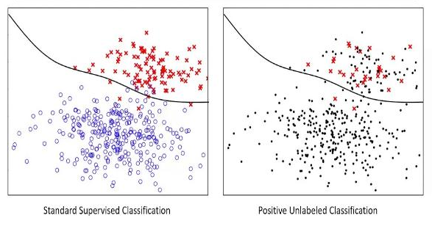
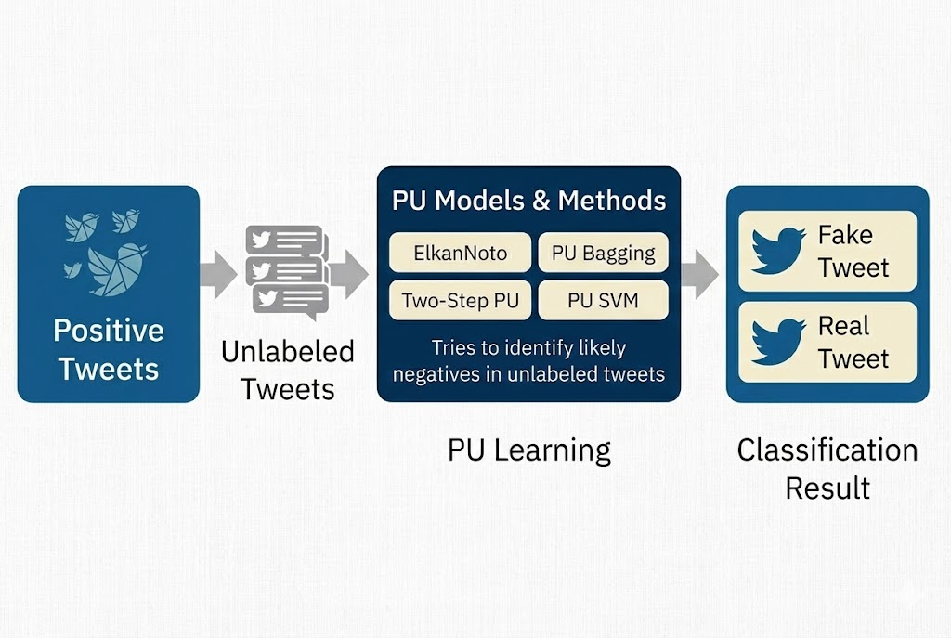
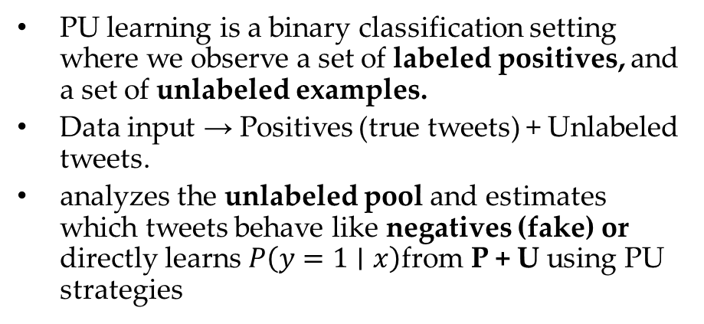
PU learning is a binary classification setting where we observe a set of labeled positives, and a set of unlabeled examples.
Data input → Positives (true tweets) + Unlabeled tweets.
analyzes the unlabeled pool and estimates which tweets behave like negatives (fake) or directly learns $P\left(y=1∣x\right)$from P + U using PU strategies
Goal : To detect fake tweets when we mainly have,
Create a small, reliable set of labeled true tweets
a large unlabeled set that mixes true and fake

Slide 25
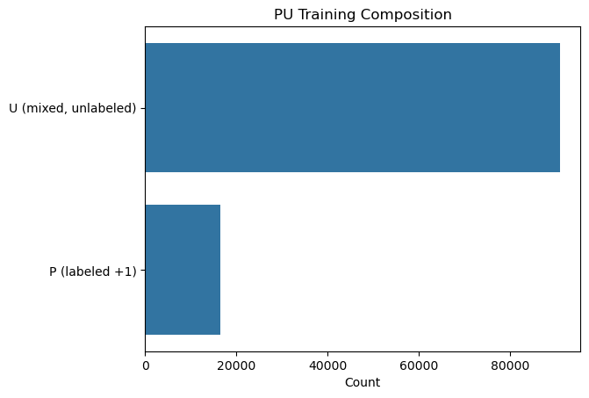
Methodology & PU Setup
Construct PU sets on the train split only
Keep only 30% of the true tweets as labeled Positives (P)
Move remaining true tweets + all fake tweets into the Unlabeled pool (U)
This creates a mixed U set that contains:
Negatives (fake tweets)
Hidden positives (true tweets with labels removed)
Apply PU method (Elkan Noto, PU SVM, PU Bagging, Two step PU)
Evaluate Model Performance
Compare Supervised predictions Vs PU methods
Positives
Real Tweet
1’s
Negatives
Fake Tweet
0’s
Labeled Positives (P): 16,556 tweets 1’s
Unlabeled pool (U, mixed): 90,802 tweets 0’s
~52000 – Fake tweets. ~38000 – Real Tweets

Slide 26
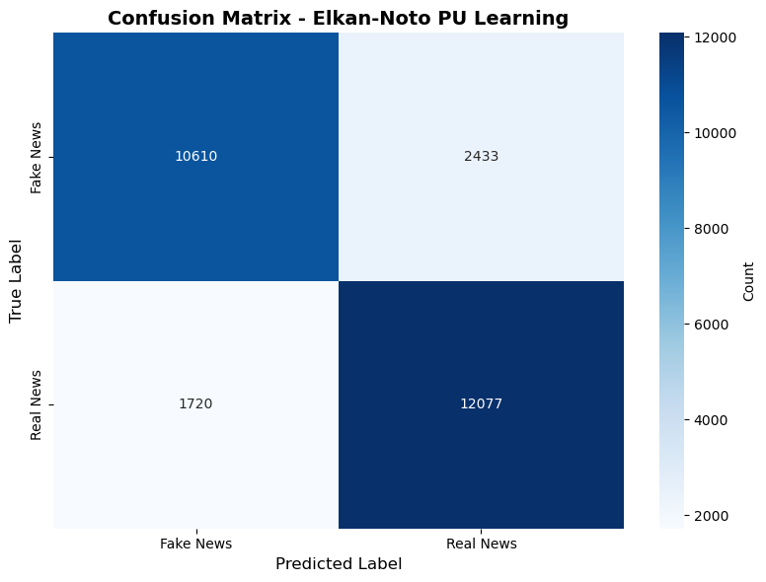
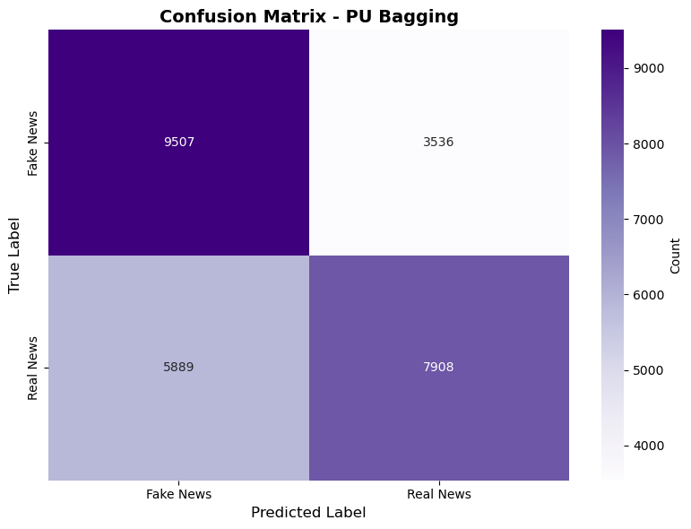
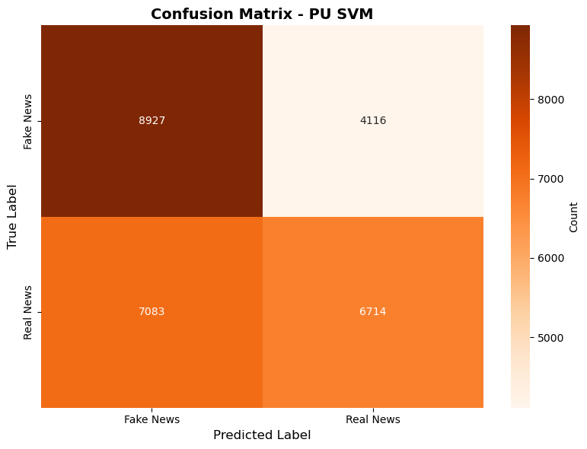
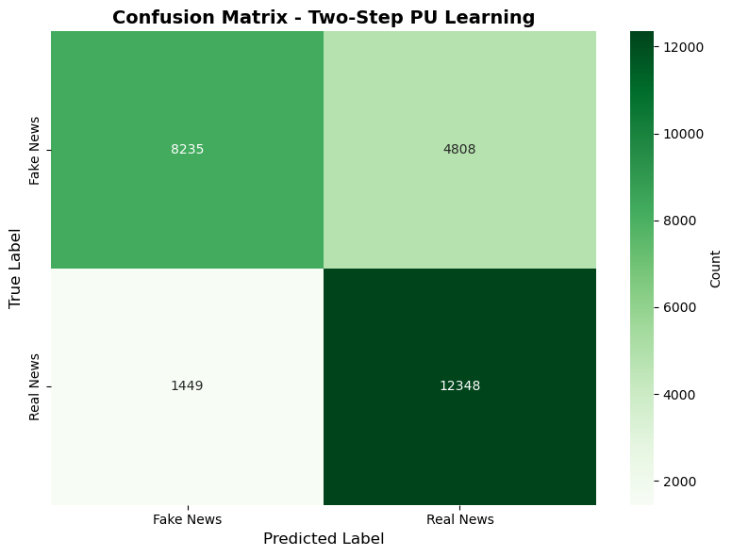
PU Learning - Confusion Matrix
Elkan–Noto PU: Best overall balance – high correct Fake and Real counts, with relatively low mistakes in both directions.
PU Bagging: Catches many Fake tweets, but mislabels a large number of Real tweets as Fake (more false alarms).
PU SVM: Highest confusion – struggles with both classes, giving the lowest correct Real predictions among all methods.
Two-Step PU: Very good at protecting Real news (few Real→Fake errors), but misses many Fake tweets (more Fake→Real).
Notes:
For each plot, rows are the true labels and columns are the predicted labels for Fake vs Real news.
The Elkan–Noto PU model gives the most balanced behavior: it correctly classifies the majority of both fake and real tweets, and the off-diagonal counts are relatively small, so it doesn’t miss too many fakes and also doesn’t wrongly flag many real tweets.
PU Bagging is more aggressive; it successfully catches a lot of fake tweets, but it also mislabels a large number of real tweets as fake, so it has more false alarms.
PU SVM struggles the most in this PU setting – both types of mistakes are high, and it produces the lowest number of correctly predicted real tweets.
Two-Step PU is very conservative: it is excellent at recognizing real news and has the fewest real→fake errors, but the trade-off is that it misses many fake tweets which are predicted as real. Overall, among these PU strategies, Elkan–Noto provides the best balance between detecting fake news and preserving real news.

Slide 27
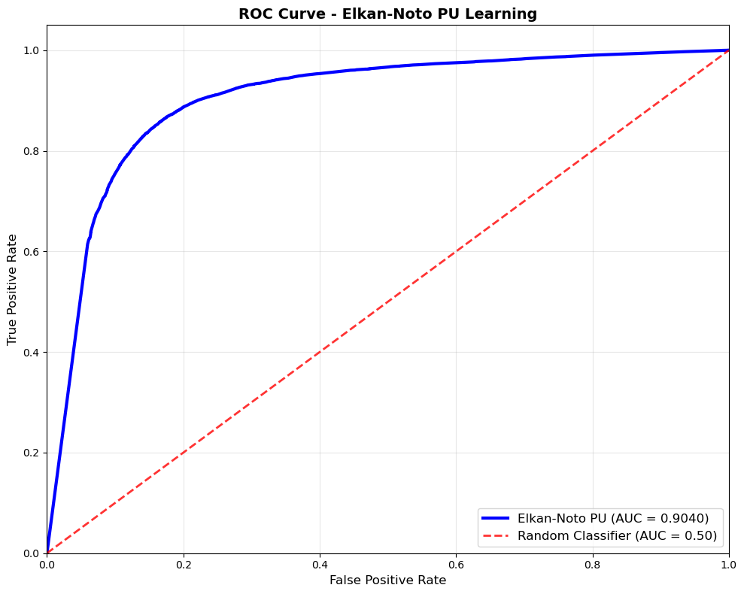
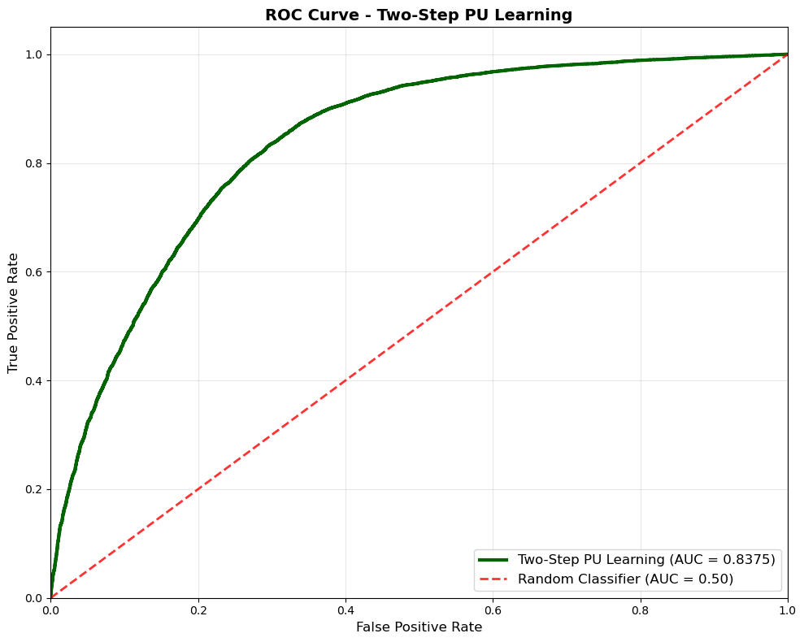
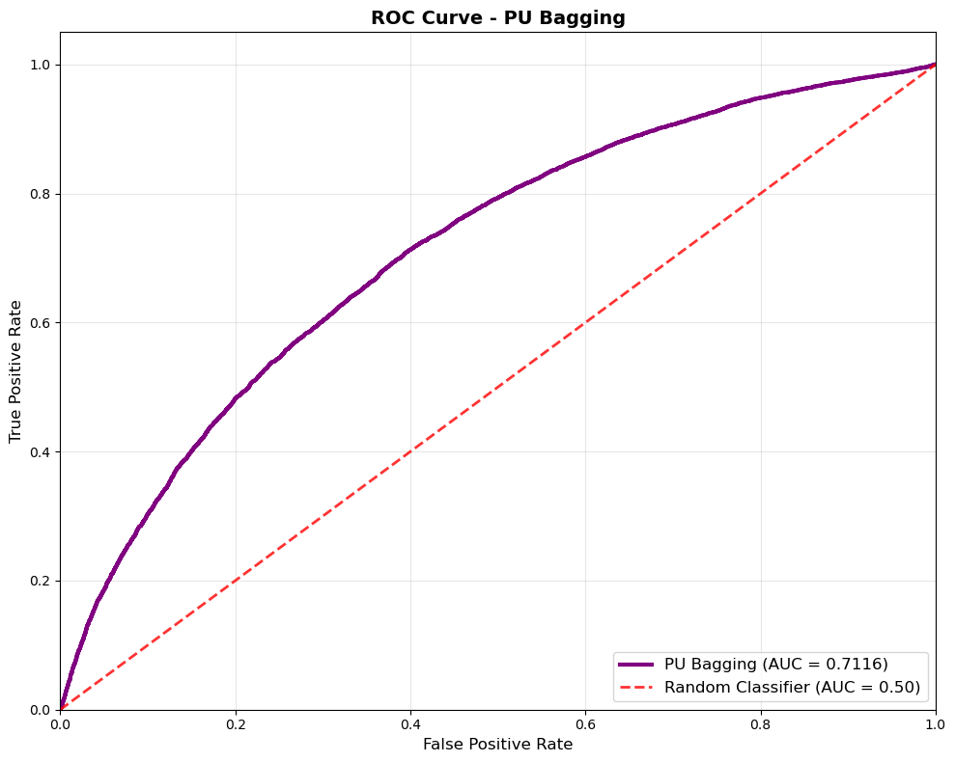
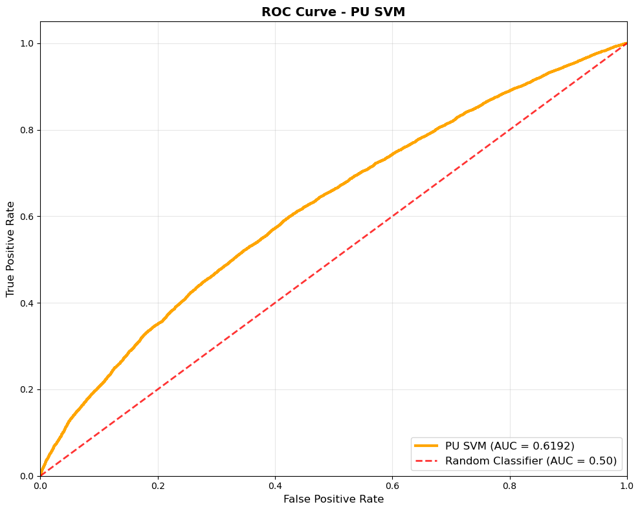
ROC-AUC Curves
Elkan–Noto PU shows the best separation between true and fake tweets among PU methods, but still below the supervised models.
Two-Step PU is a reasonable second choice; PU Bagging and especially PU SVM have only modest discrimination.
All PU ROC curves lie below the supervised ROC curves because the model trains on positives + noisy unlabeled data, not on full, clean labels.
The models with PU bagging approach and PU SVM underperforms than other PU methods.
Notes:
Elkan–Noto PU is the strongest here, with an AUC of about 0.90. It separates the classes reasonably well across thresholds, but it’s still below the performance of our best supervised models.
Two-Step PU is next at around 0.84, showing decent discrimination but clearly below Elkan–Noto. PU Bagging is around 0.71, and PU SVM is the weakest at about 0.62, only slightly better than random. So the ranking is: Elkan–Noto > Two-Step PU > PU Bagging > PU SVM.
Compared to supervised learning, all PU curves are lower. This is expected: in PU learning the model only sees positives and a noisy unlabeled pool where fakes and true tweets are mixed together. We deliberately hide many labels, so the algorithm has less information and also has to cope with hidden positives inside U, which makes it harder to learn a clean decision boundary. Because of that reduced and noisy supervision, PU models naturally perform worse than fully supervised models on the same test set.

Slide 28
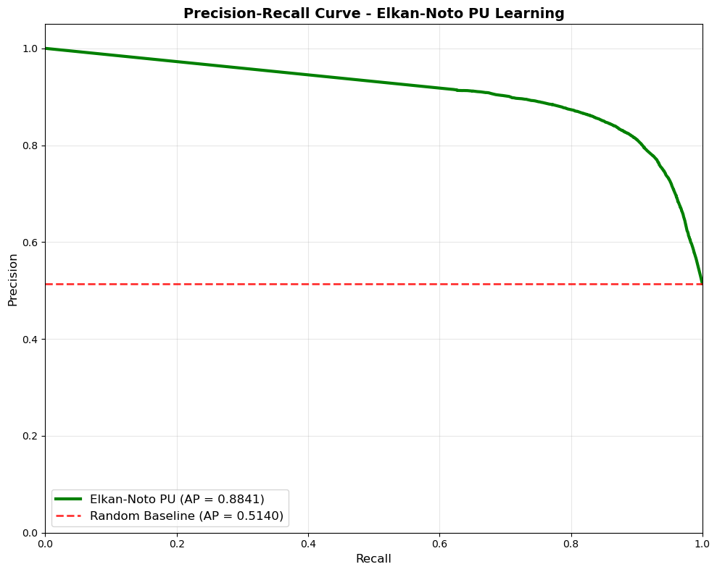



Precision Recall Curves for PU Learning
Elkan–Noto PU has the highest Average Precision (AP ≈ 0.88) – high precision is maintained even at high recall
Two-Step PU is second (AP ≈ 0.82), with slightly lower precision but still a strong curve
PU Bagging is moderate (AP ≈ 0.70); precision drops more quickly as we try to recall more positives
PU SVM is the weakest (AP ≈ 0.63), only a bit better than the random baseline (AP ≈ 0.51)
Notes:
Precision tells us, “when the model predicts a tweet as true, how often is it correct?”, and recall tells us, “how many of the actual true tweets did we recover?” The dashed red line is the random baseline with an average precision around 0.51.
Elkan–Noto PU has the best curve, with an average precision close to 0.88. Its precision stays high even as we increase recall, which means it can retrieve many true tweets without introducing too many mistakes.
Two-Step PU comes next with an AP of about 0.82. It’s slightly below Elkan–Noto, but still keeps reasonably good precision over most recall levels.
PU Bagging drops to an AP of around 0.70, so precision falls off faster when we try to capture more positives. PU SVM is the weakest with AP around 0.63, only slightly above the random baseline.
these precision–recall curves confirm the same pattern we saw before: Elkan–Noto and Two-Step PU are the most useful PU strategies on this dataset

Slide 29


PU Final Metrics
Model | Accuracy (%) | Precision (%) | Recall (%) | F1-Score | ROC-AUC | PR-AUC
Elkan-Noto PU | 84.53 | 88.41 | 87.53 | 85.33 | 90.40 | 88.41
PU Bagging | 64.88 | 70.39 | 64.59 | 64.76 | 71.16 | 70.39
PU SVM | 58.27 | 61.99 | 48.66 | 54.53 | 61.92 | 62.80
Two-Step PU | 76.69 | 71.97 | 89.50 | 79.79 | 83.75 | 81.98
Notes:
Elkan–Noto and Two-Step sit in the higher band of 75–85%, while Bagging and SVM are grouped lower. That tells us the ranking is not driven by a single metric but is consistent across accuracy, F1, ROC-AUC and PR-AUC.
Two-Step PU pushes recall higher at the expense of precision, whereas Elkan–Noto keeps both fairly high and balanced. So depending on whether we care more about catching every true tweet or avoiding false alarms, we’d choose a different PU method.
Finally, this lets us compare back to the supervised results: all numbers are about 8–10 points lower, which quantifies how much performance we lose when we switch from full labels to a realistic Positive + Unlabeled setting.

Slide 30

Notes:
The upper block shows the supervised models. Most of them – Logistic Regression, Random Forest, XGBoost, LightGBM and the Ensemble – sit in the 90%+ range for most metrics, which appears as darker green/blue. The one clear weak supervised model is SVM, which is noticeably more yellow, especially on recall and F1.
Below the dashed line are the PU models. We can see a consistent downward shift in color: scores drop roughly 8–15 percentage points when we move from full labels to Positive + Unlabeled data. Among PU methods, Elkan–Noto PU and Two-Step PU form the stronger band, while PU Bagging and PU SVM stay in the orange/yellow region.
An interesting point is that the best PU model (Elkan–Noto) reaches performance comparable to the worst supervised model (supervised SVM). So even with many labels hidden and noisy unlabeled data, PU learning can still match a traditional supervised baseline, but there is a clear “supervision gap” compared to the top supervised models.

Slide 31


Slide 32
Existing Work
Notes:
Precision tells us, “when the model predicts a tweet as true, how often is it correct?”, and recall tells us, “how many of the actual true tweets did we recover?” The dashed red line is the random baseline with an average precision around 0.51.
Elkan–Noto PU has the best curve, with an average precision close to 0.88. Its precision stays high even as we increase recall, which means it can retrieve many true tweets without introducing too many mistakes.
Two-Step PU comes next with an AP of about 0.82. It’s slightly below Elkan–Noto, but still keeps reasonably good precision over most recall levels.
PU Bagging drops to an AP of around 0.70, so precision falls off faster when we try to capture more positives. PU SVM is the weakest with AP around 0.63, only slightly above the random baseline.
these precision–recall curves confirm the same pattern we saw before: Elkan–Noto and Two-Step PU are the most useful PU strategies on this dataset

Slide 33
Future works
Notes:
Precision tells us, “when the model predicts a tweet as true, how often is it correct?”, and recall tells us, “how many of the actual true tweets did we recover?” The dashed red line is the random baseline with an average precision around 0.51.
Elkan–Noto PU has the best curve, with an average precision close to 0.88. Its precision stays high even as we increase recall, which means it can retrieve many true tweets without introducing too many mistakes.
Two-Step PU comes next with an AP of about 0.82. It’s slightly below Elkan–Noto, but still keeps reasonably good precision over most recall levels.
PU Bagging drops to an AP of around 0.70, so precision falls off faster when we try to capture more positives. PU SVM is the weakest with AP around 0.63, only slightly above the random baseline.
these precision–recall curves confirm the same pattern we saw before: Elkan–Noto and Two-Step PU are the most useful PU strategies on this dataset

Slide 34
Conclusion
Notes:
Precision tells us, “when the model predicts a tweet as true, how often is it correct?”, and recall tells us, “how many of the actual true tweets did we recover?” The dashed red line is the random baseline with an average precision around 0.51.
Elkan–Noto PU has the best curve, with an average precision close to 0.88. Its precision stays high even as we increase recall, which means it can retrieve many true tweets without introducing too many mistakes.
Two-Step PU comes next with an AP of about 0.82. It’s slightly below Elkan–Noto, but still keeps reasonably good precision over most recall levels.
PU Bagging drops to an AP of around 0.70, so precision falls off faster when we try to capture more positives. PU SVM is the weakest with AP around 0.63, only slightly above the random baseline.
these precision–recall curves confirm the same pattern we saw before: Elkan–Noto and Two-Step PU are the most useful PU strategies on this dataset

Slide 35
Thank you
Dr. Charan Gudla
Major Professor
Department of Computer Science Bagley College of Engineering
Mississippi State University
Mississippi, United States
Dr. Zhiqian Chen
Committee Member
Department of Computer Science Bagley College of Engineering
Mississippi State University
Mississippi, United States
Dr. Jon Woody,
Committee Member
Department of Mathematics & Statistics Bagley College of Engineering
Mississippi State University
Mississippi, United States

